Slide 1
WELCOME TO NEW JERSEY SPEECH AND DEBATE
JUDGE WORKSHOP

Slide 2
WORKSHOP OVERVIEW
THE FUNDAMENTALS OF SPEECH AND DEBATE
TOURNAMENT LOGISTICS AND PROTOCOLS
THE REPONSIBILITIES OF STUDENTS
THE RESPONSIBILITIES OF JUDGES
ONLINE (ELECTRONIC) AND PAPER BALLOTING
BREAK OUT SESSIONS

Slide 3
THE FUNDAMENTALS:

Slide 4
PURPOSE
We are an organization dedicated to the purpose of fostering a healthy competitive environment where:
Students can find their voice
Students can develop critical thinking skills
Students can learn from constructive criticism
Students can find acceptance in a diverse and tolerant learning community

Slide 5
FINDING VOICE:
OPPORTUNITIES ARE ENDLESS
IN SPEECH:
INTERPRETATION: Dramatic, Humorous, Duo, Prose and Poetry Reading, Program Oral Interpretation, and Improvisational Acting
PUBLIC ADDRESS: Declamation, Original Oratory, Informative Speaking, Extemporaneous Speaking, and Impromptu Speaking
IN DEBATE:
PUBLIC FORUM
LINCOLN DOUGLAS
CONGRESSIONAL
WORLD
PARLIAMENTARY
POLICY

Slide 6
BASIC VOCABULARY
JUDGES’ LOUNGE: A gathering place, where information is disseminated and refreshments (breakfast, lunch, snacks, and beverages) are typically served.
JUDGE CALL: Frequently 30 minutes before the round starts; it is the tournament director’s way of assessing whether all judges are available. If a judge does not respond, a replacement is assigned, and the school is assessed a financial penalty.
SCHEMATICS: The blasting of all judge and student assignments (on paper and/or electronically) to rooms of competition.
RFD: Reason for Decision: whether speech or debate, students need to know why you have decided how they placed in the room, or why they won or lost a round.
BYE: Not a greeting; this indicates that there are an odd number of contestants, and one debate competitor or team sits out that round with a win.
BREAK: A competitor advances to an “out” round. It is “Break a leg” worthy!
OUT ROUND: This means you are “in” (judge and/or competitor) the next round of competition. Each advancement is determined by the size of the tournament.

Slide 7
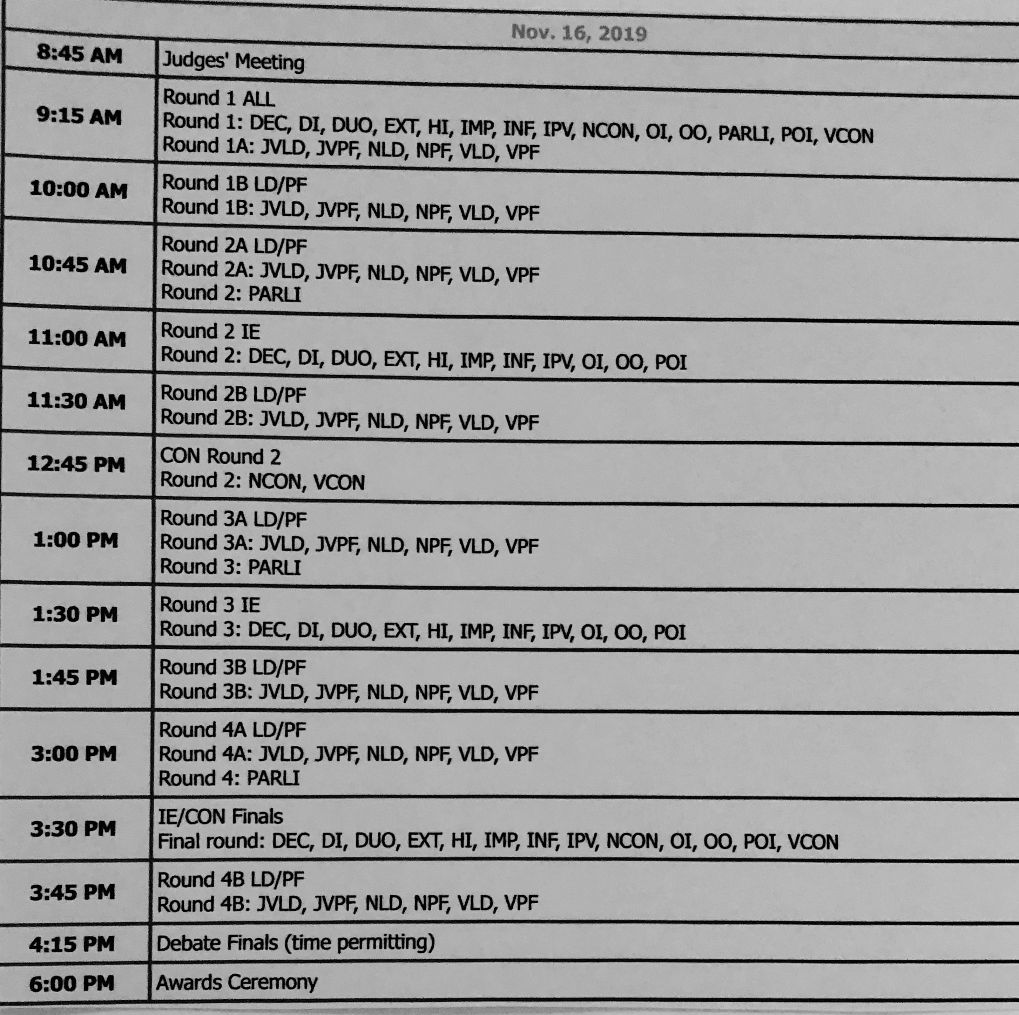
Tournament Logistics: Scheduling

Slide 8
SCHEMATICS
IN SPEECH:
DI: Round 3
JUDGE: M.GORMLEY
ROOM: T222
A 900 Cynthia Jones
C 933 Melvin Colley
F 942 Natalie Portman
BB 935 James Oglethorpe
J 987 Adina Menzel
P 964 Sean Hayes
IN DEBATE:
PF: Round 2
JUDGE: P. KRAMER
ROOM: H111
FLIGHT A: DELBARTON JZ vs MONTVILLE MT
FLIGHT B: REGIS TP vs POLYPREP GC

Slide 9
STUDENTS’ RESPONSIBILITIES
IN SPEECH:
Name: Jane Smith
Code: D 555
Title: The Outsiders
Author: S.E. Hinton
Possible notes:
DE: means double entered: placement in round should be prioritized; may leave upon completion of performance
DEWR: also double entered; will return following performance in their other event.
IN DEBATE
Name(s): Smith: Millburn PS:
PRO or AFF
or
Smith and Jones: Ridge SJ
CON or NEG
In Congress: Students will identify themselves by name each time they speak.

Slide 10
JUDGES’ RESPONSIBILITIES
IN SPEECH
Attend judge meeting; every tournament has different protocols driven by their administrations.
Arrive at your room as soon as possible. If there is a judge call in a central location (typically to guarantee your presence, and distribution of paper ballots) pick up ballot and go to room. OR if notified electronically, go to room asap.
Establish your credibility; do not reveal experience; follow the schematic as much as possible.
PROVIDE TIME SIGNAL WHEN REQUIRED OR REQUESTED
Rank the room 1 -6/7; provide constructive criticism to validate your rank.
IN DEBATE
Attend judge meeting; every tournament has different protocols driven by their administrations.
Arrive at your room as soon as possible. If there is a judge call in a central location (typically to guarantee your presence, and distribution of paper ballots) pick up ballot and go to room. OR if notified electronically, go to room asap.
Establish your credibility; do not reveal experience.
PROVIDE TIME SIGNALS or Keep time (even when the students keep their own time.)
Determine the winner in the round, and provide a reason for your decision (RFD). Indicate what arguments led to that decision. Provide speakers points for each debater.

Slide 11
PAPER AND ONLINE E-BALLOTS
NEW JERSEY SPEECH AND DEBATE TOURNAMENTS:
The majority of local tournaments (NJSDL and Newark CFL) are platformed on speechwire.com. For these competitions, you will be required to provide your email address to the coach of record from your school; you will receive an email prior to each round regarding your room assignment and contestants.
Most National circuit tournaments, including the NJ District Tournament, Ridge Debates, Yale, Tournament of Champions, NSDA Nationals, etc. are on tabroom.com. You can open an account on that website on your own, and link that account to your school. At tournaments using this platform you will receive an email and a text message regarding your assignment.

Slide 12
PAPER vs E-BALLOTS
The obvious difference between paper and e-ballots is that one is handwritten, the other is typed.
When handwriting ballots, legibility is important. Feedback is vital in this activity, so the student relies on the criticism you have written.
When typing ballots, avoid pounding on your computer, as the noise may be a detrimental to the performance. It is ok to take written notes when watching, and then fill in the ballots after you have ranked. Ranking MUST be immediate to keep the tournament on time. Just do not become distracted and forget that necessary feedback.

Slide 13
E-BALLOTS (continued)
REASONS FOR MOVING TO E-BALLOTS:
Reduction of paper waste: fewer schematic postings; fewer ballots. It’s good for the environment!
Time efficiency; computers have expedited tabulation.
Time to fill out your ballots effectively following the posting of your results (ranks in speech; win/loss in debate).
The posting of your paradigm is efficient. On tabroom.com, debate judges have the opportunity to post their paradigm ahead of time, so that the debaters can adapt to those preferences. In speech, the judges can provide their criteria for judging for all the competitors in the room, before evaluating each contestant’s individual performance. This cuts down on repetitive narratives.
Your ballot is between you and the tab staff, and ultimately the student and coach. No second and third hand parties have access to your critiques.

Slide 14
HELP: I HEAR YOU
Here are some videos that have been made to help to facilitate training for judges on how to use online ballots:
How to create a Tabroom account: https://youtu.be/DyTqMwhRJpo
How to complete a debate ballot online: https://youtu.be/-SrO56i4M1I
How to complete a speech ballot online: https://youtu.be/prCyYf-KbM0
How to complete a congress ballot online: https://youtu.be/FkvC6qQNbxc

Slide 15
MORE RESOURCES
YOU ARE NOT ALONE!
WHERE CAN I GO FOR FURTHER HELP?
www.njsdl.org provides a judges’ manual, sample ballots, the scope of our schedule, and email addresses of the State leadership.
www.speechanddebate.org provides infinite resources, sample ballots, and tutorials, as well as videos of the National finals going back over a decade. Take a look at the prestigious alumni that have belonged to the National Speech and Debate Association.

Slide 16
Q & A
WE WELCOME GENERAL QUESTIONS BUT, SPECIFICS ABOUT RULES WILL BE MAPPED OUT IN BREAK-OUTS WITH THE FOLLOWING PRESENTERS:
IN SPEECH: ANNE POYNER from SUMMIT HS
IN PUBLIC FORUM: AMISHA MEHTA from WESTFIELD
IN LINCOLN DOUGLAS: LAURIE SCHMID from PHILLIPSBURG
IN CONGRESS: LA JUAN FOUST from DELBARTON
Facilitated by MARY GORMLEY, NJ DISTRICT CHAIR from DELBARTON

Slide 17
THANK YOU FOR JUDGING!

